Slide 1
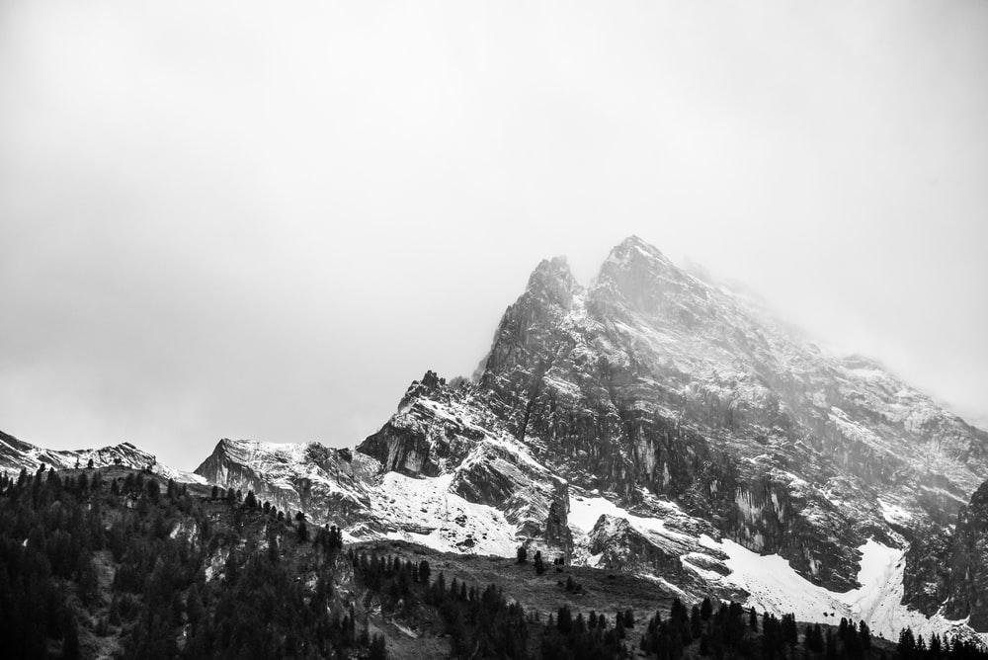
Portifize
Mission and Value Proposition
Notes:
Ashwin: Hello, my name is Ashwin, and these are my team members Leah, Ella, and Avi, and we are Portifize.

Slide 2
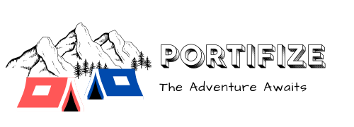
Mission Statement
Our group’s mission is to assist homeless citizens living in inclimate weather by creating an affordable, efficient, and portable shelter that can withstand various weather conditions.
Notes:
Avi

Slide 3

Problem Statement
Many homeless people
Do not have enough income to afford permanent and effective shelter
Sleep in unsafe and uncomfortable environments
Need a sense of privacy and personal space
Need protection from cold and sickness
Need somewhere to store and protect their personal belongings
Notes:
Avi: Many homeless people do not have enough income to afford permanent and effective shelter and thus settle for sleeping in unsafe and uncomfortable environments. However, by using our portable shelter design, homeless people will gain a sense of privacy and personal space, protection from cold and sickness, and the ability to store and protect their personal belongings.

Slide 4

Business Model
1 for 1 business model
For every shelter sold in stores, we will donate one to a homeless person in need
Provide shelter free of charge to homeless people
Expands user base to two markets: campers and homeless people.
Notes:
Ashwin: Our business will operate under the 1 for 1 model. For every shelter sold in stores, we will donate one to a homeless person in need. This model allows us to provide shelter free of charge to homeless people and expands our user base to two markets: campers and homeless people.

Slide 5
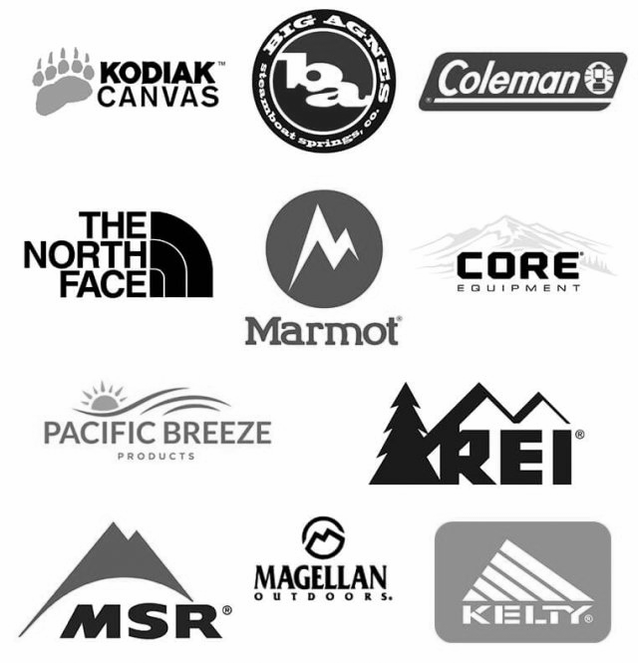
Competition
Many competitors with products similar to ours
Not many tent and backpack combinations
Environmentally friendly
1 for 1 business model
Support a good cause and fulfill their personal satisfaction by helping other people.
Notes:
Ella: Because camping is such a large market, there are many competitors out there with products similar to ours. However, there aren’t many products on the market whose design combines a tent and backpack into one. our 1 for 1 business model will also give us a competitive advantage over other brands. Users will be more inclined to buy our product to support a good cause and fulfill their personal satisfaction by helping others.

Slide 6
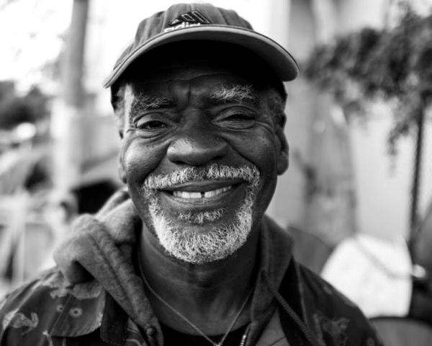
Market Size and User Base
Homeless Population
Camping Population
Total Market Size
Approximately 28,000,000 people in the U.S
Ample opportunity to sell, and donate our product
Over 10,000 people in Columbus.
Future Market
We can also expand our market to the military and toy sectors.
Notes:
Leah: Over 10,000 people in columbus alone don’t know where they will sleep tonight. Across the United States, that number is upwards of 600,000. The estimated market size for camping products is nearly 28,000,000 and growing every year. Because this market is so large, there is ample opportunity to sell, and thus donate, our product. In the future, our users could expand into the military and toy market. However, our primary focus and goal is supporting the homeless community so our design will revolve mainly around their needs and expectations.

Slide 7
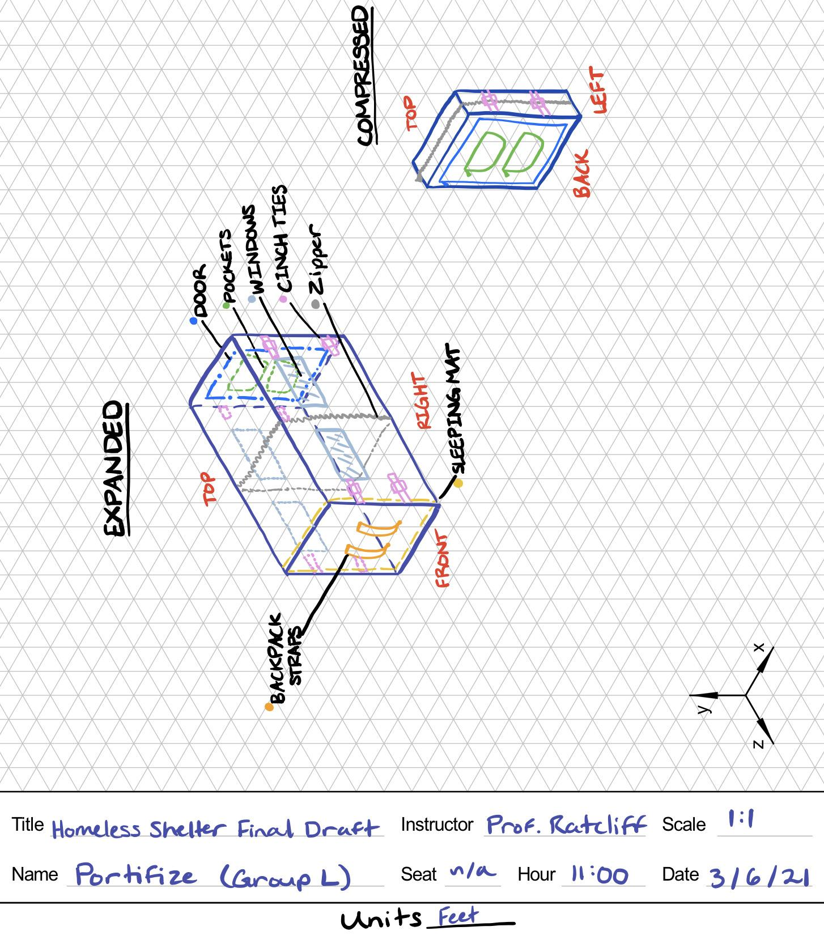
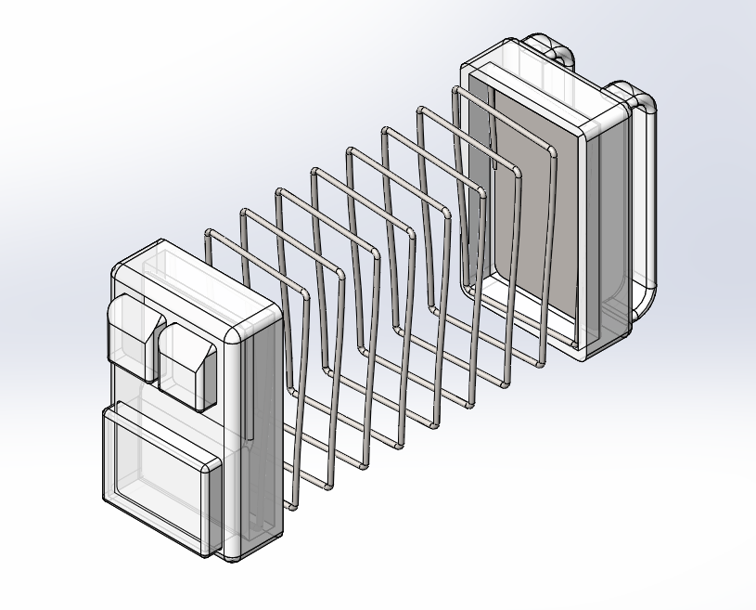
Product Description
Backpack unzips and automatically expands into a shelter
2.5 x 4 x 1 compressed
2.5 x 4 x 7 expanded
Window feature to provide ample visibility to users
Bedding pad built into backpack
Design goals: < 20 lbs, < 6 ft^3, < 45 N force needed to compress
Notes:
(Leah)

Slide 8
Citations
https://invisiblepeople.tv/videos/elderly-homeless-man-venice-beach/
https://policyadvice.net/insurance/insights/homelessness-statistics/#:%7E:text=On%20a%20single%20night%2C%20more,are%20living%20on%20the%20streets
https://www.statista.com/statistics/555795/estimated-number-of-homeless-people-in-the-us/
Notes:
Our sources.

